Slide 1
Topic 3: Integrated gate circuit and flip-flop
Switching characteristics of semiconductor devices, TTL gate, CMOS gate.
Flip-flop

Slide 2
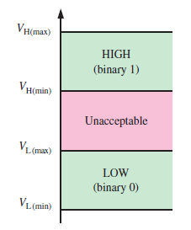
Logic Levels
The voltages used to represent logic 0 or 1 are called logic levels.
HIGH can be any voltage between a specified minimum and a specified maximum.
LOW can be any voltage between a specified minimum and a specified maximum.
No overlap between the accepted range of HIGH levels and the accepted range of LOW levels.

Slide 3
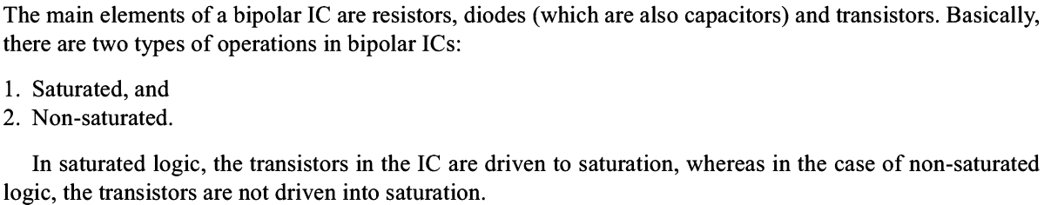
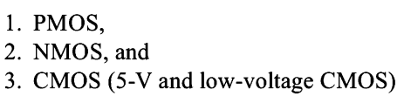
Logic Family

Slide 4
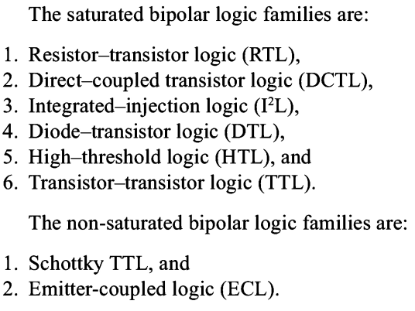
Logic Family

Slide 5
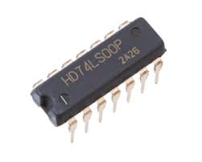
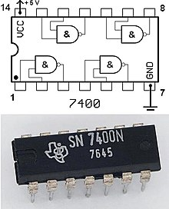
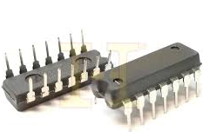
Logic Family
7400 IC is a 4 x 2-input NAND gate

Slide 6
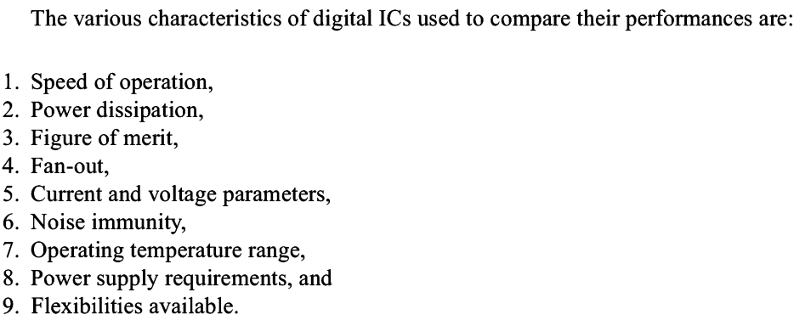
Logic Family

Slide 7
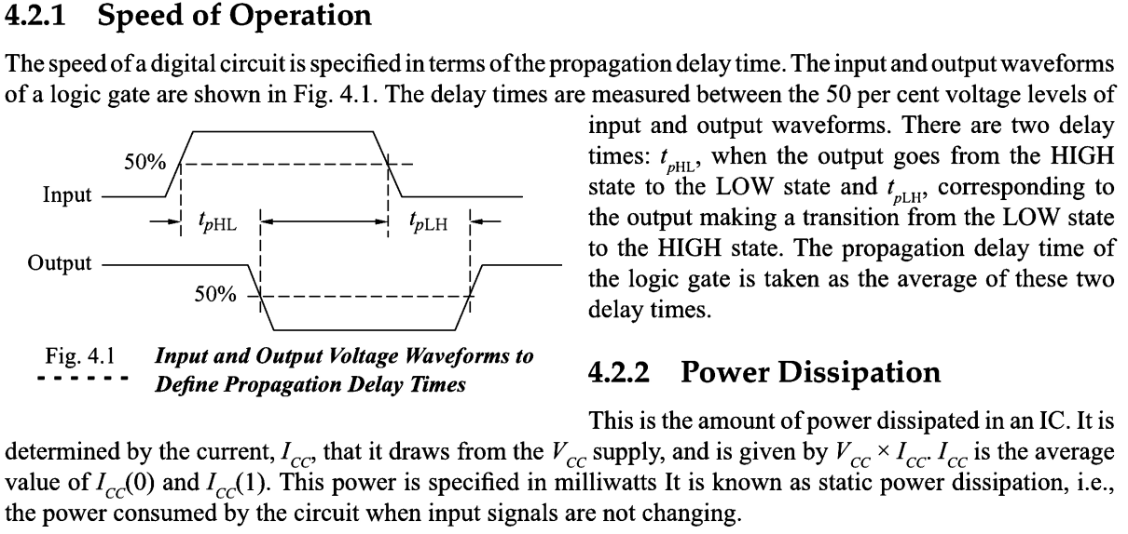
Logic Family

Slide 8
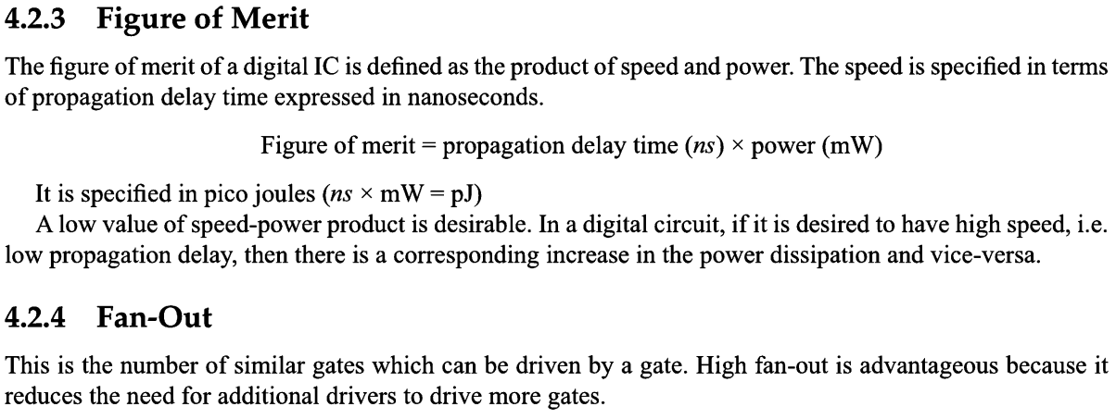
Logic Family

Slide 9
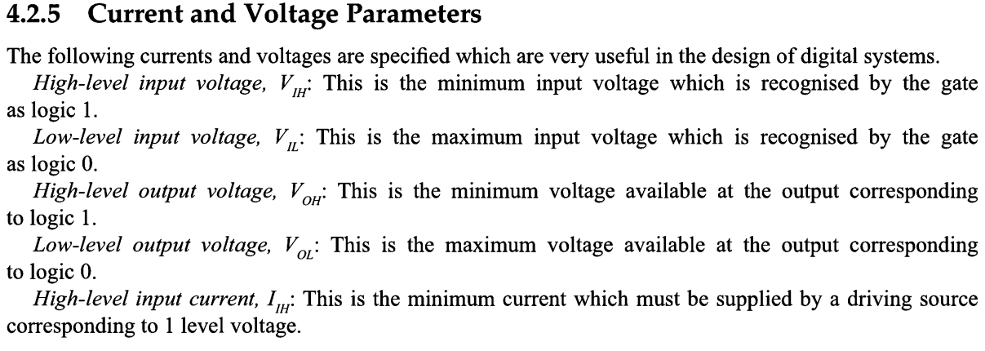
Logic Family

Slide 10
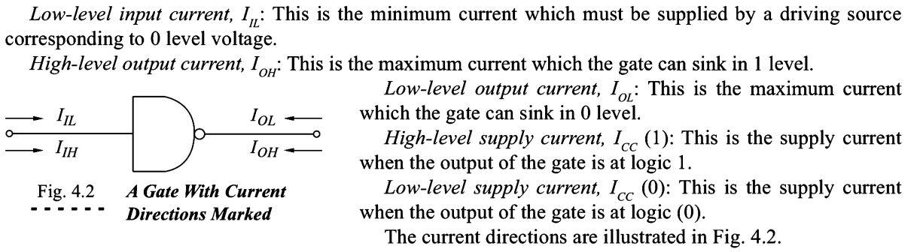
Logic Family

Slide 11
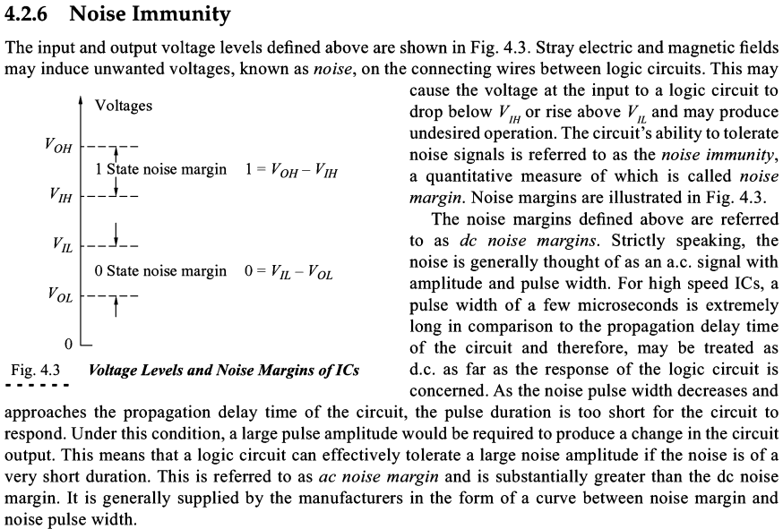
Logic Family

Slide 12
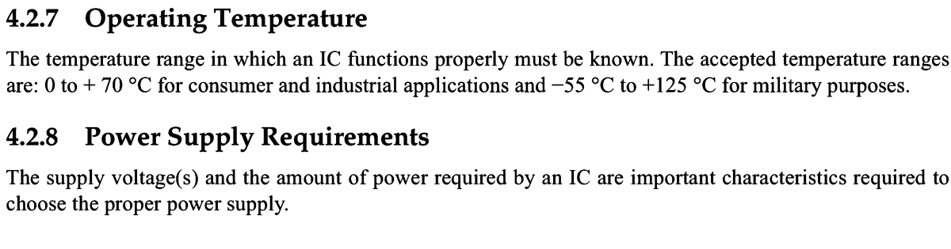
Logic Family

Slide 13
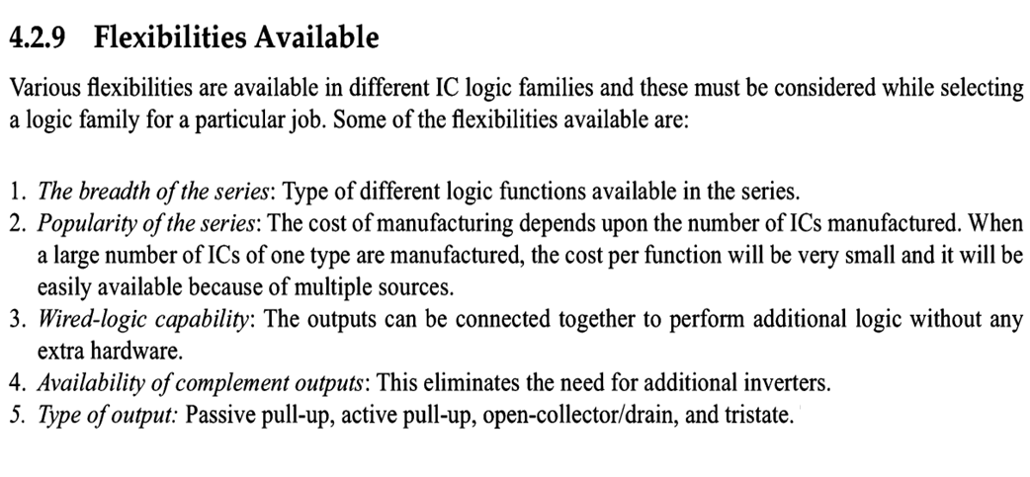
Logic Family

Slide 14
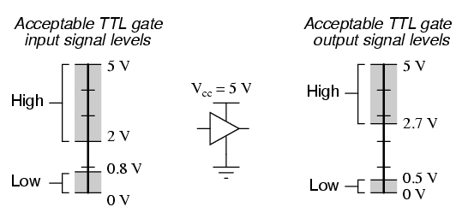
TTL gate
TTL stands for transistor-transistor logic.

Slide 15
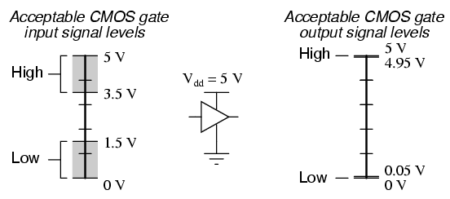
CMOS gate
CMOS stands for complementary metal-oxide semiconductor.

Slide 16
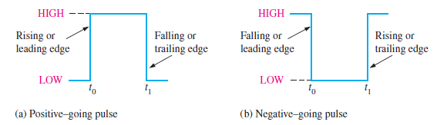
Switching characteristics of semiconductor devices
Digital waveforms consist of voltage levels that are changing back and forth between the HIGH and LOW levels.
Rising edge (or positive edge) happens when digital signal goes from LOW to HIGH.
Falling edge (or negative edge) happens when digital signal goes from HIGH to LOW.

Slide 17
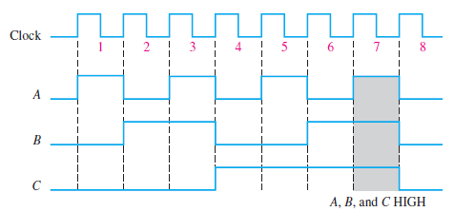
Timing Diagram
A timing diagram is a graph of digital waveforms showing the actual time relationship of two or more waveforms and how each waveform changes in relation to the others.

Slide 18
Sequential Logic Circuits
Consists of both combinational
logic circuits and memory
elements.
Memory elements are
constructed from bistable
logic circuits called ‘flip-flops’.
Output depends on current
inputs and previous output state.
i/p
Combinational
circuits
o/p
Memory

Slide 19
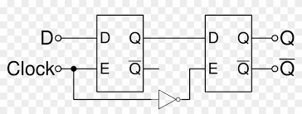
Synchronous and Asynchronous Sequential Circuits
Asynchronous sequential circuits:
Outputs and state change as soon as an input changes.
Synchronous sequential circuits:
Outputs and state change depending on a special input (clock).
FF1
FF2
Q1
D1
Q2
D2

Slide 20
Bistable Elements
1
Q
Has two stable conditions (states).
Can be used to store binary logic.
If Q = high, feedback to inverter 2 will cause its output to be low, which also forces the output of inverter 1 to be high. So this is a stable state.
If Q = low, feedback to inverter 2 will cause its output to be high, which also forces the output of inverter 1 to be low. So this is the second stable state.
Q
2

Slide 21
Latches and Flip-flops
Sequential circuits have outputs that depend on both the present state and the sequence of past inputs. To be able to remember past inputs, sequential circuits contain memory devices called latches and flip-flops.
Both latches and flip-flops can be in one or more stable states (bistable) and have one or more inputs that can be used to change the outputs.
Flip-flops have clock inputs whereas latches have no clock inputs.

Slide 22
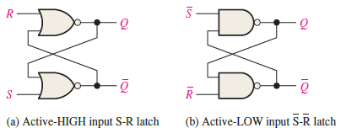
SR Latch
A latch is a type of bistable logic device.
An active HIGH input SR (SET-RESET) latch is formed with two cross-coupled NOR gates. See figure (a) below.
An active LOW input S’R’ latch is formed with two cross-coupled NAND gates. See figure (b) below.

Slide 23
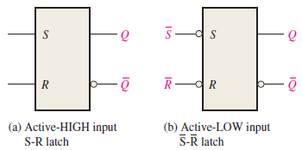
SR Latch (Continued)
A latch can reside in either one of its two states, SET or RESET.
SET means that the Q output is HIGH
RESET means that the Q output is LOW.
The logic symbols for SR latches are shown here.

Slide 24
Latches
SR Latch
S R Q₀ | Q | Q’
0 0 0
0 | 1
Q = Q₀
0
0
0
1
Initial Value

Slide 25
Latches
SR Latch
S R Q₀ | Q | Q’
0 0 0 | 0 | 1
0 0 1
Q = Q₀
1 | 0
Q = Q₀
0
1
0
0

Slide 26
Latches
SR Latch
S R Q₀ | Q | Q’
0 0 0 | 0 | 1
0 0 1 | 1 | 0
0 1 0 | 0
Q = Q₀
1
 | 1
Q = 0
0
0
1

Slide 27
Latches
SR Latch
S R Q₀ | Q | Q’
0 0 0 | 0 | 1
0 0 1 | 1 | 0
0 1 0 | 0 | 1
0 1 1
Q = Q₀
1
Q = 0
1
0 | 1
Q = 0
0
0

Slide 28
Latches
SR Latch
S R Q₀ | Q | Q’
0 0 0 | 0 | 1
0 0 1 | 1 | 0
0 1 0 | 0 | 1
0 1 1 | 0 | 1
1 0 0
Q = Q₀
0
0
Q = 0
1 | 0
Q = 1
1
1

Slide 29
Latches
SR Latch
S R Q₀ | Q | Q’
0 0 0 | 0 | 1
0 0 1 | 1 | 0
0 1 0 | 0 | 1
0 1 1 | 0 | 1
1 0 0 | 1 | 0
1 0 1
Q = Q₀
0
1
Q = 0
Q = 1
1 | 0
Q = 1
1
0

Slide 30
Latches
SR Latch
S R Q₀ | Q | Q’
0 0 0 | 0 | 1
0 0 1 | 1 | 0
0 1 0 | 0 | 1
0 1 1 | 0 | 1
1 0 0 | 1 | 0
1 0 1 | 1 | 0
1 1 0
Q = Q₀
1
0
Q = 0
Q = 1
0 | 0
Q = Q’
1
1
0

Slide 31
Latches
SR Latch
S R Q₀ | Q | Q’
0 0 0 | 0 | 1
0 0 1 | 1 | 0
0 1 0 | 0 | 1
0 1 1 | 0 | 1
1 0 0 | 1 | 0
1 0 1 | 1 | 0
1 1 0 | 0 | 0
1 1 1
Q = Q₀
1
1
Q = 0
0
Q = 1
Q = Q’
0 | 0
Q = Q’
1
0

Slide 32
Latches
SR Latch
S R | Q
0 0 | Q₀
0 1 | 0
1 0 | 1
1 1 | Q=Q’=0
No change
Reset
Set
Invalid
S’ R’ | Q
0 0 | Q=Q’=1
0 1 | 1
1 0 | 0
1 1 | Q₀
Invalid
Set
Reset
No change

Slide 33
Gated SR Latch
A gated latch requires and enable input EN for enable (G is also used to designate an enable input).
When EN is HIGH, the S and R inputs control the state of the latch just as discussed in previous slides.
When EN is LOW, no change occurs.
The input EN is to enable the latch to respond to new inputs S and R when the inputs S and R are ready.

Slide 34
Timing Diagram of a gated SR latch
Note that the gated SR latch only functions normally as an SR latch when the EN input is HIGH.
When EN input is LOW, the output Q does not change (the latch stores its previous output).

Slide 35
Gated D Latch
A gated D latch has only one input D (data) and an input enable EN (enable).
When the D input is HIGH and the EN input is HIGH, the latch will be set i.e. the Q output is HIGH.
When the D input is LOW and EN is HIGH, the latch will reset i.e. Q = 0.
When the EN is low, the output has no change.

Slide 36
Timing Diagram of a Gated D Latch
Note that when input EN is HIGH, the gated D latch operates like a normal latch.
When input EN is LOW, the gated D latch keeps its previous output unchanged (store previous output state).

Slide 37
Latch as level-sensitive device
Latch is a level-sensitive device, meaning the outputs change when the levels of the inputs change (LOW or HIGH).
Another device we will look at in the next slide is flip-flop which is an edge sensitive device.
An edge sensitive device means the outputs change at the edges of the triggering input called clock (CLK).

Slide 38


Any Questions

